Slide 1


AI; in Human Terms
1
2
3
4
5
6
7
8
9
0
May 2025
is just another technology
Practical applications of AI
SLACS
1
2
3
4
5
6
7
8
9
10

Slide 2
AI; is just another technology
1
2
3
4
5
6
7
8
9
0
May 2025
in Human Terms
SLACS
1
2
3
4
5
6
7
8
9
10

Slide 3
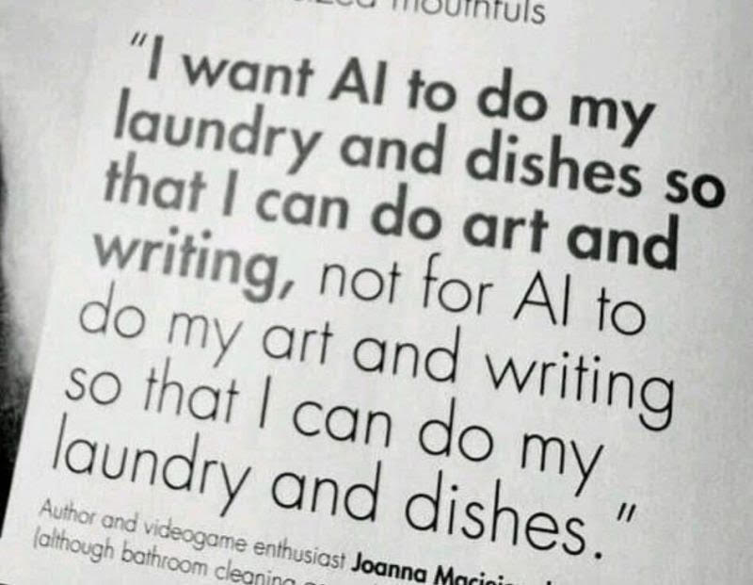

Slide 4

AI Adoption
Multi-agent
ROI
Autopilot
Copilot
Time

Slide 5
AI Adoption Curve
Copilot
Autopilot
Multi-agent
Basic automation
Examples:
Email writing
Minute taking
Insight Automation
1.5x
Almost total automation
Examples:
Call handling
7x
Total automation
Examples:
A full team of AI ‘users’
20x
Complaint automation

Slide 6
AI Adoption Curve
Multi-agent
Copilot
Total automation
Examples:
A full team of AI ‘users’
20x
Helping you understand what people think
Almost total automation
Examples:
Call handling
7x

Slide 7
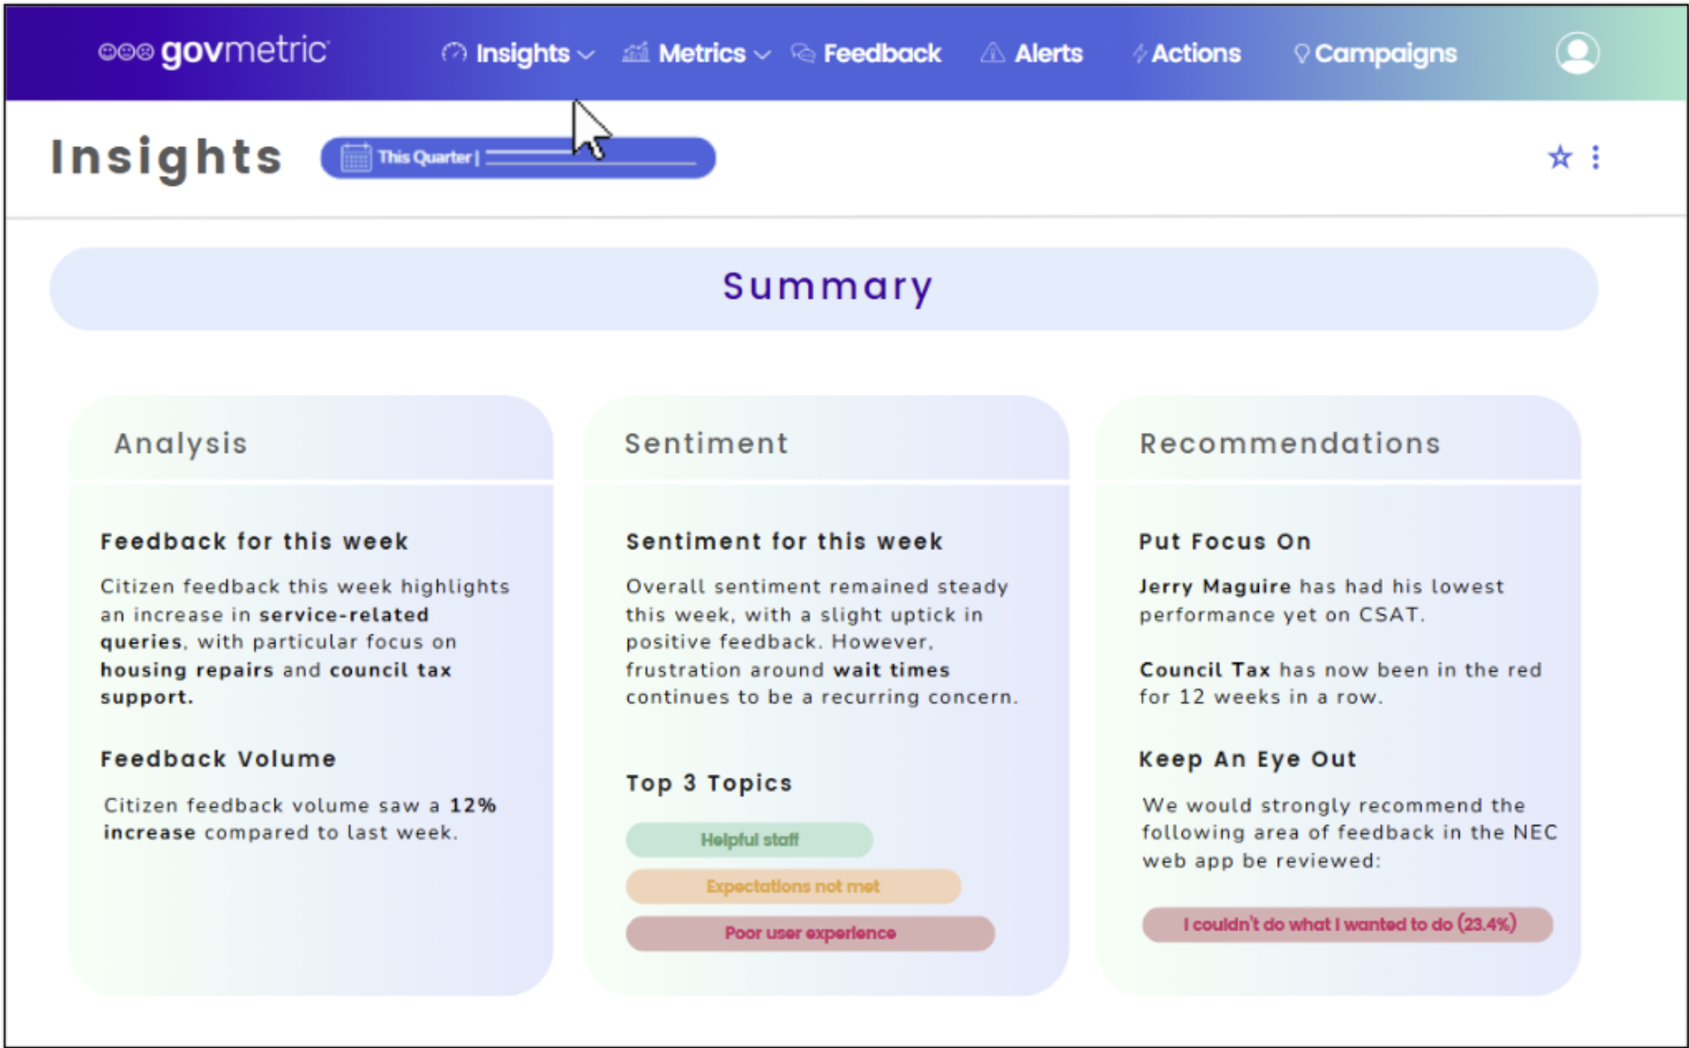

Slide 8
AI Adoption Curve
Multi-agent
Autopilot
Total automation
Examples:
A full team of AI ‘users’
20x
Chatbots became a dirty word
Almost total automation
Examples:
Call handling
7x

Slide 9
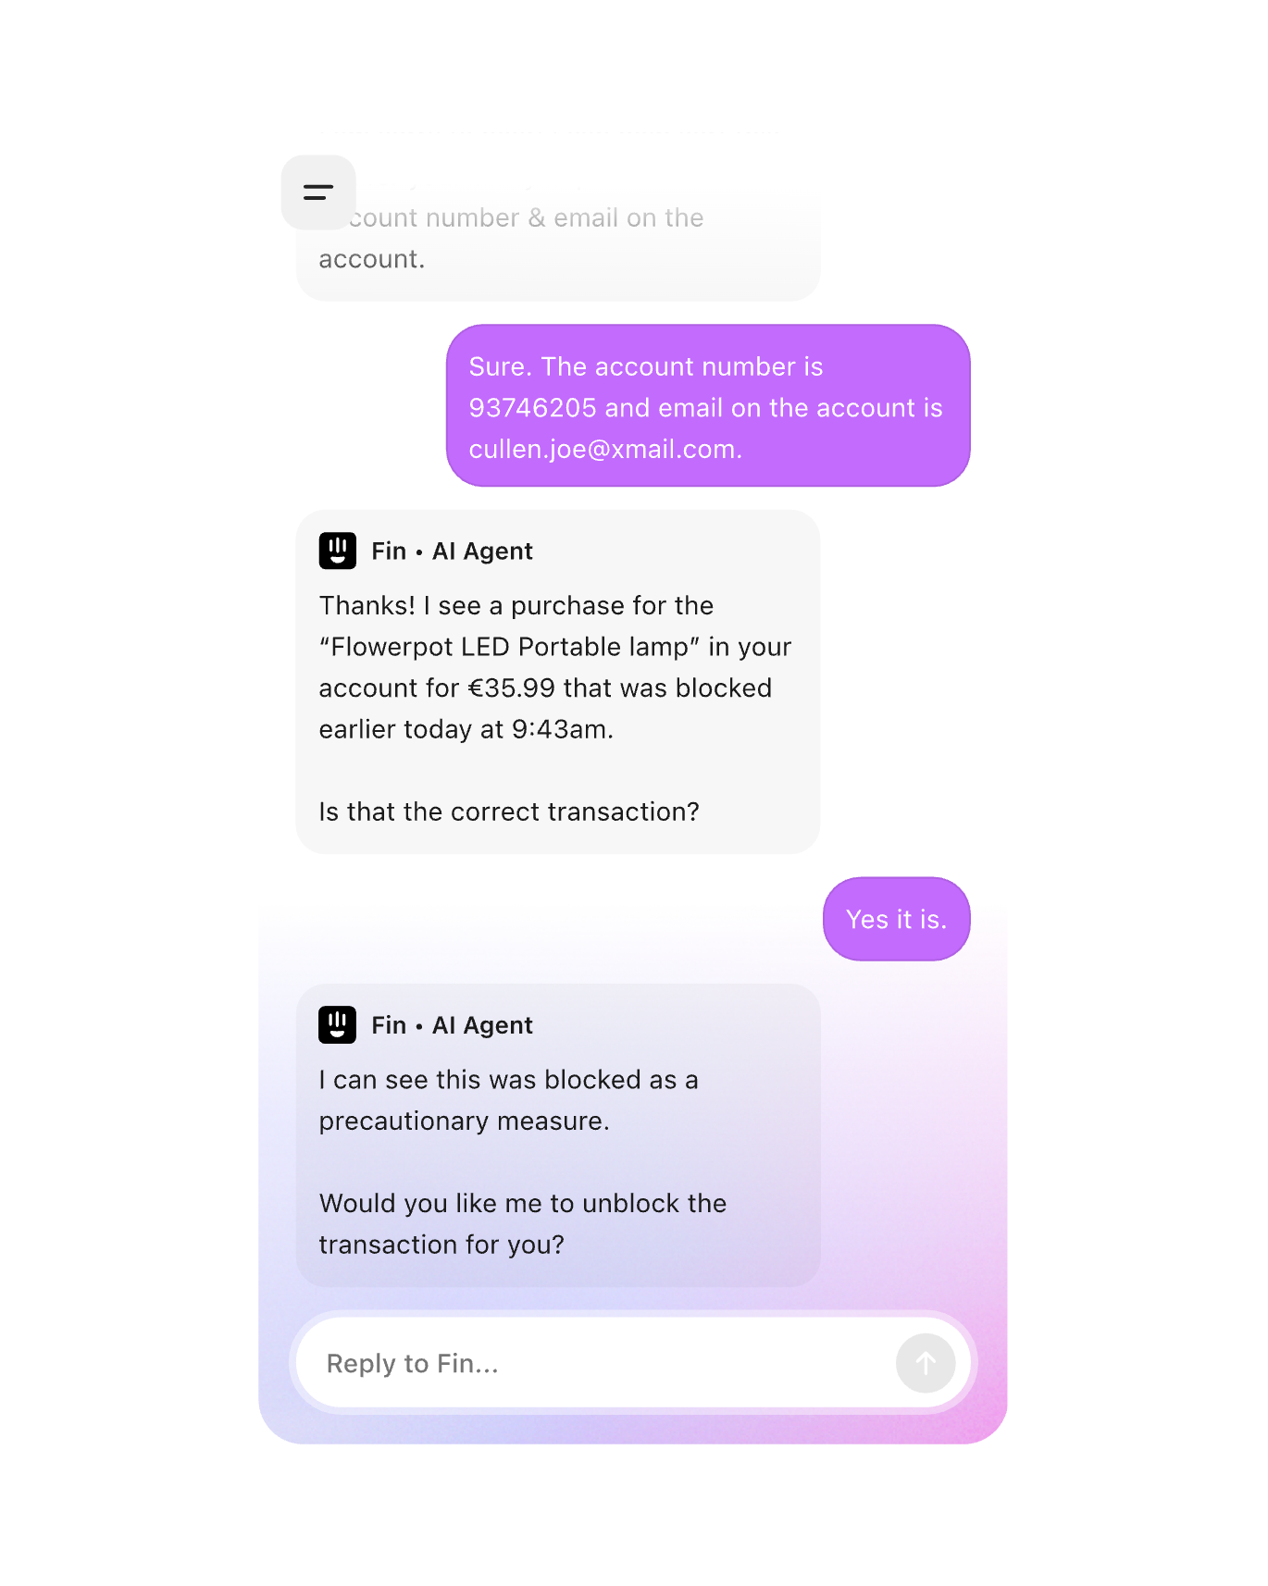
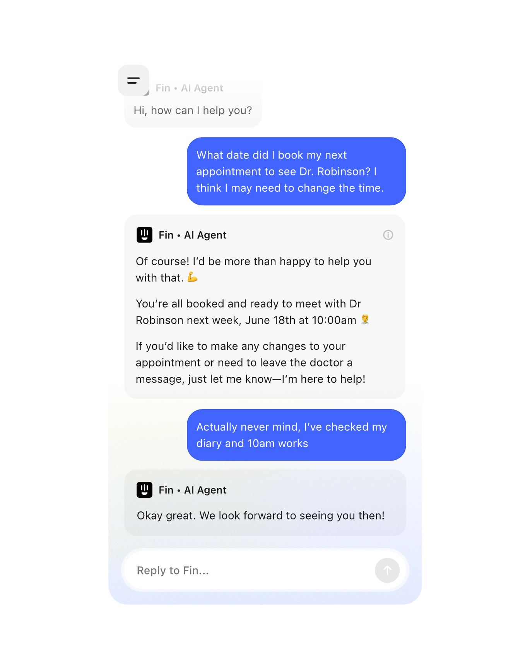
A new Generation
Just imagine these connected to your revs, bens, housing, waste systems.
AI Next Gen
Notes:
JOHN

Slide 10
AI Adoption Curve
Multi-agent
Autopilot
Total automation
Examples:
A full team of AI ‘users’
20x
Complaint automation
Almost total automation
Examples:
Call handling
7x

Slide 11
Octavia The Complaint Agents
AI Next Gen
Notes:
JOHN

Slide 12
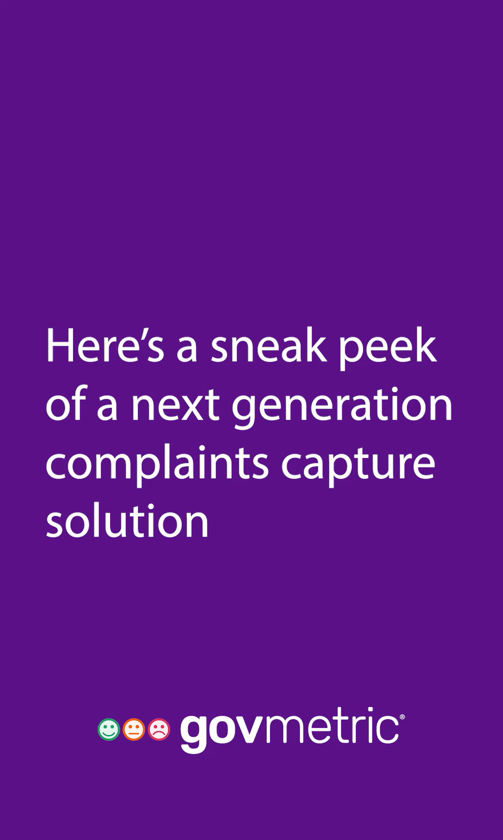
Autopilot
Complaint automation

Slide 13
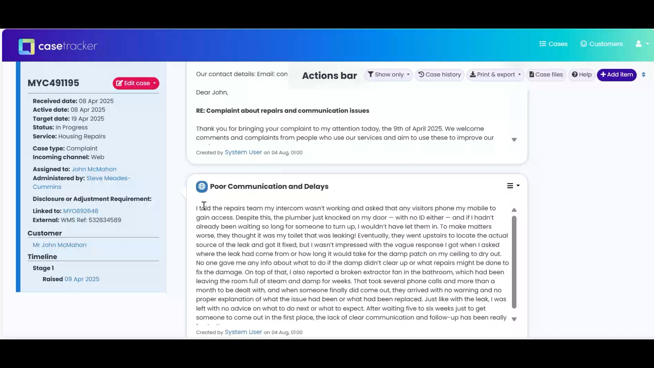

Slide 14

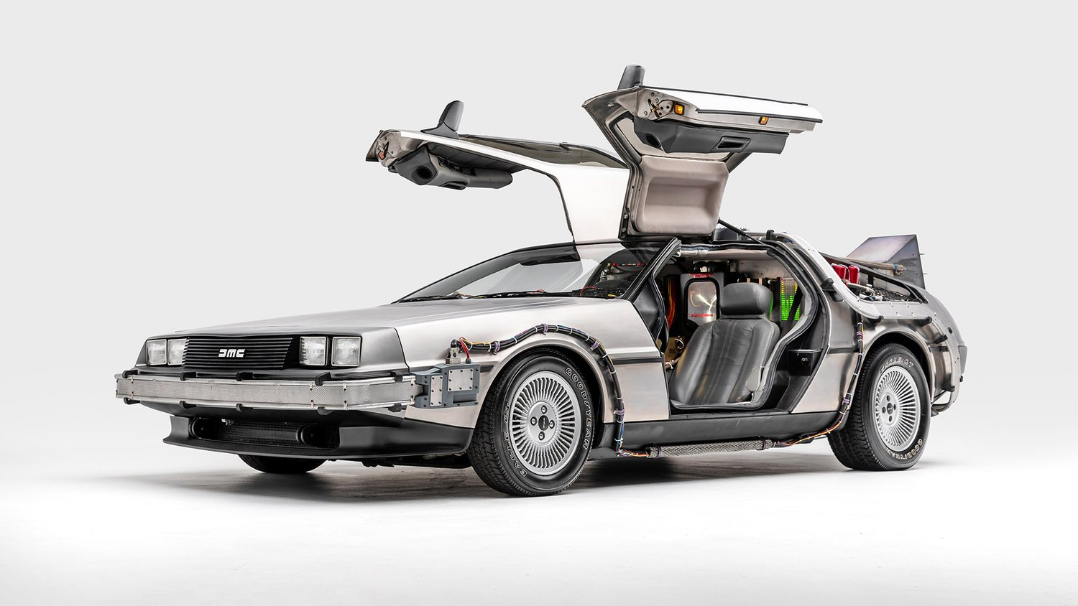

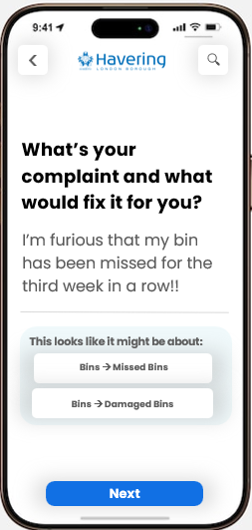

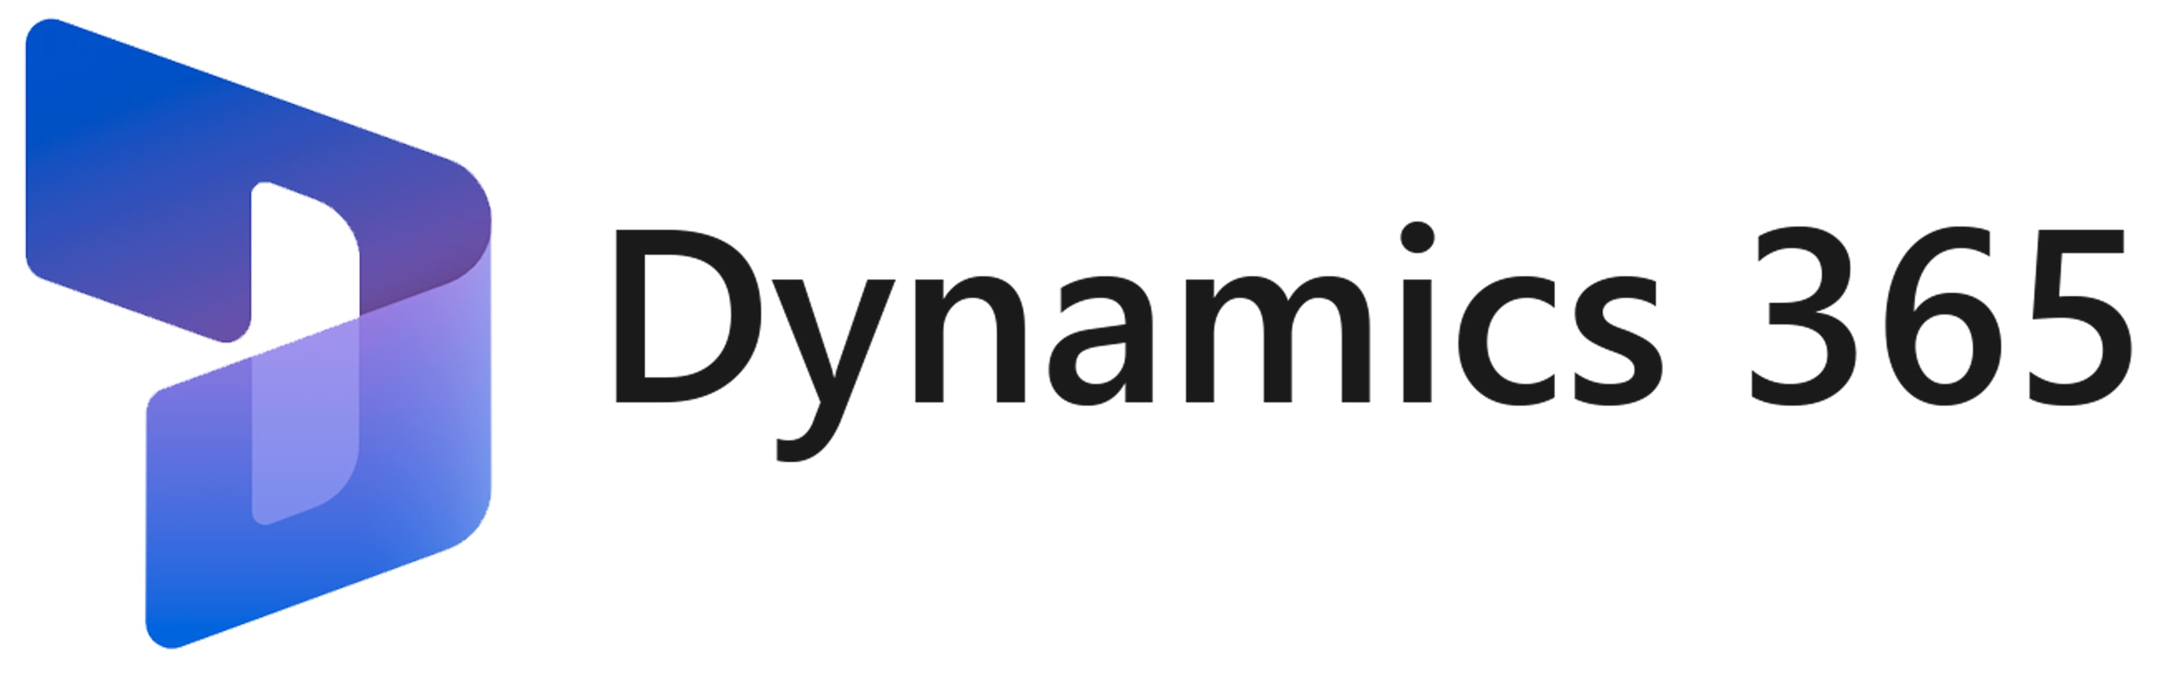




Checks if it’s a service request
Checks if it’s a valid complaint
Check if more info is needed
Check if it’s stage 1 or 2
Automatically allocates to service area
Confirms/chases to ensure on time
Checks all points of the complaint are answered
It’s a service request
It’s a complaint
Investigation Monitoring
Agent
Triage Agent
Personalised acknowledgement
Service Managers
Automated push to
Automated push to
Complaint Received
Add notes
Complainants
Response filed if acceptable
Investigation output passed
for response generation
Response
Agent
Reporting
Agent
Response pushed to complainant
Converts the investigation details
Into a full and complete response
Complaints Manager checks the output
Octavia The Complaint Agent
Prepares all statutory reports
Weekly/Monthly service reports
Self assessments
AI Next Gen
Notes:
JOHN

Slide 15

AI should leave time for UI/UX
1
2
3
4
5
6
7
8
9
0
May 2025
SLACS
1
2
3
4
5
6
7
8
9
10

Slide 16
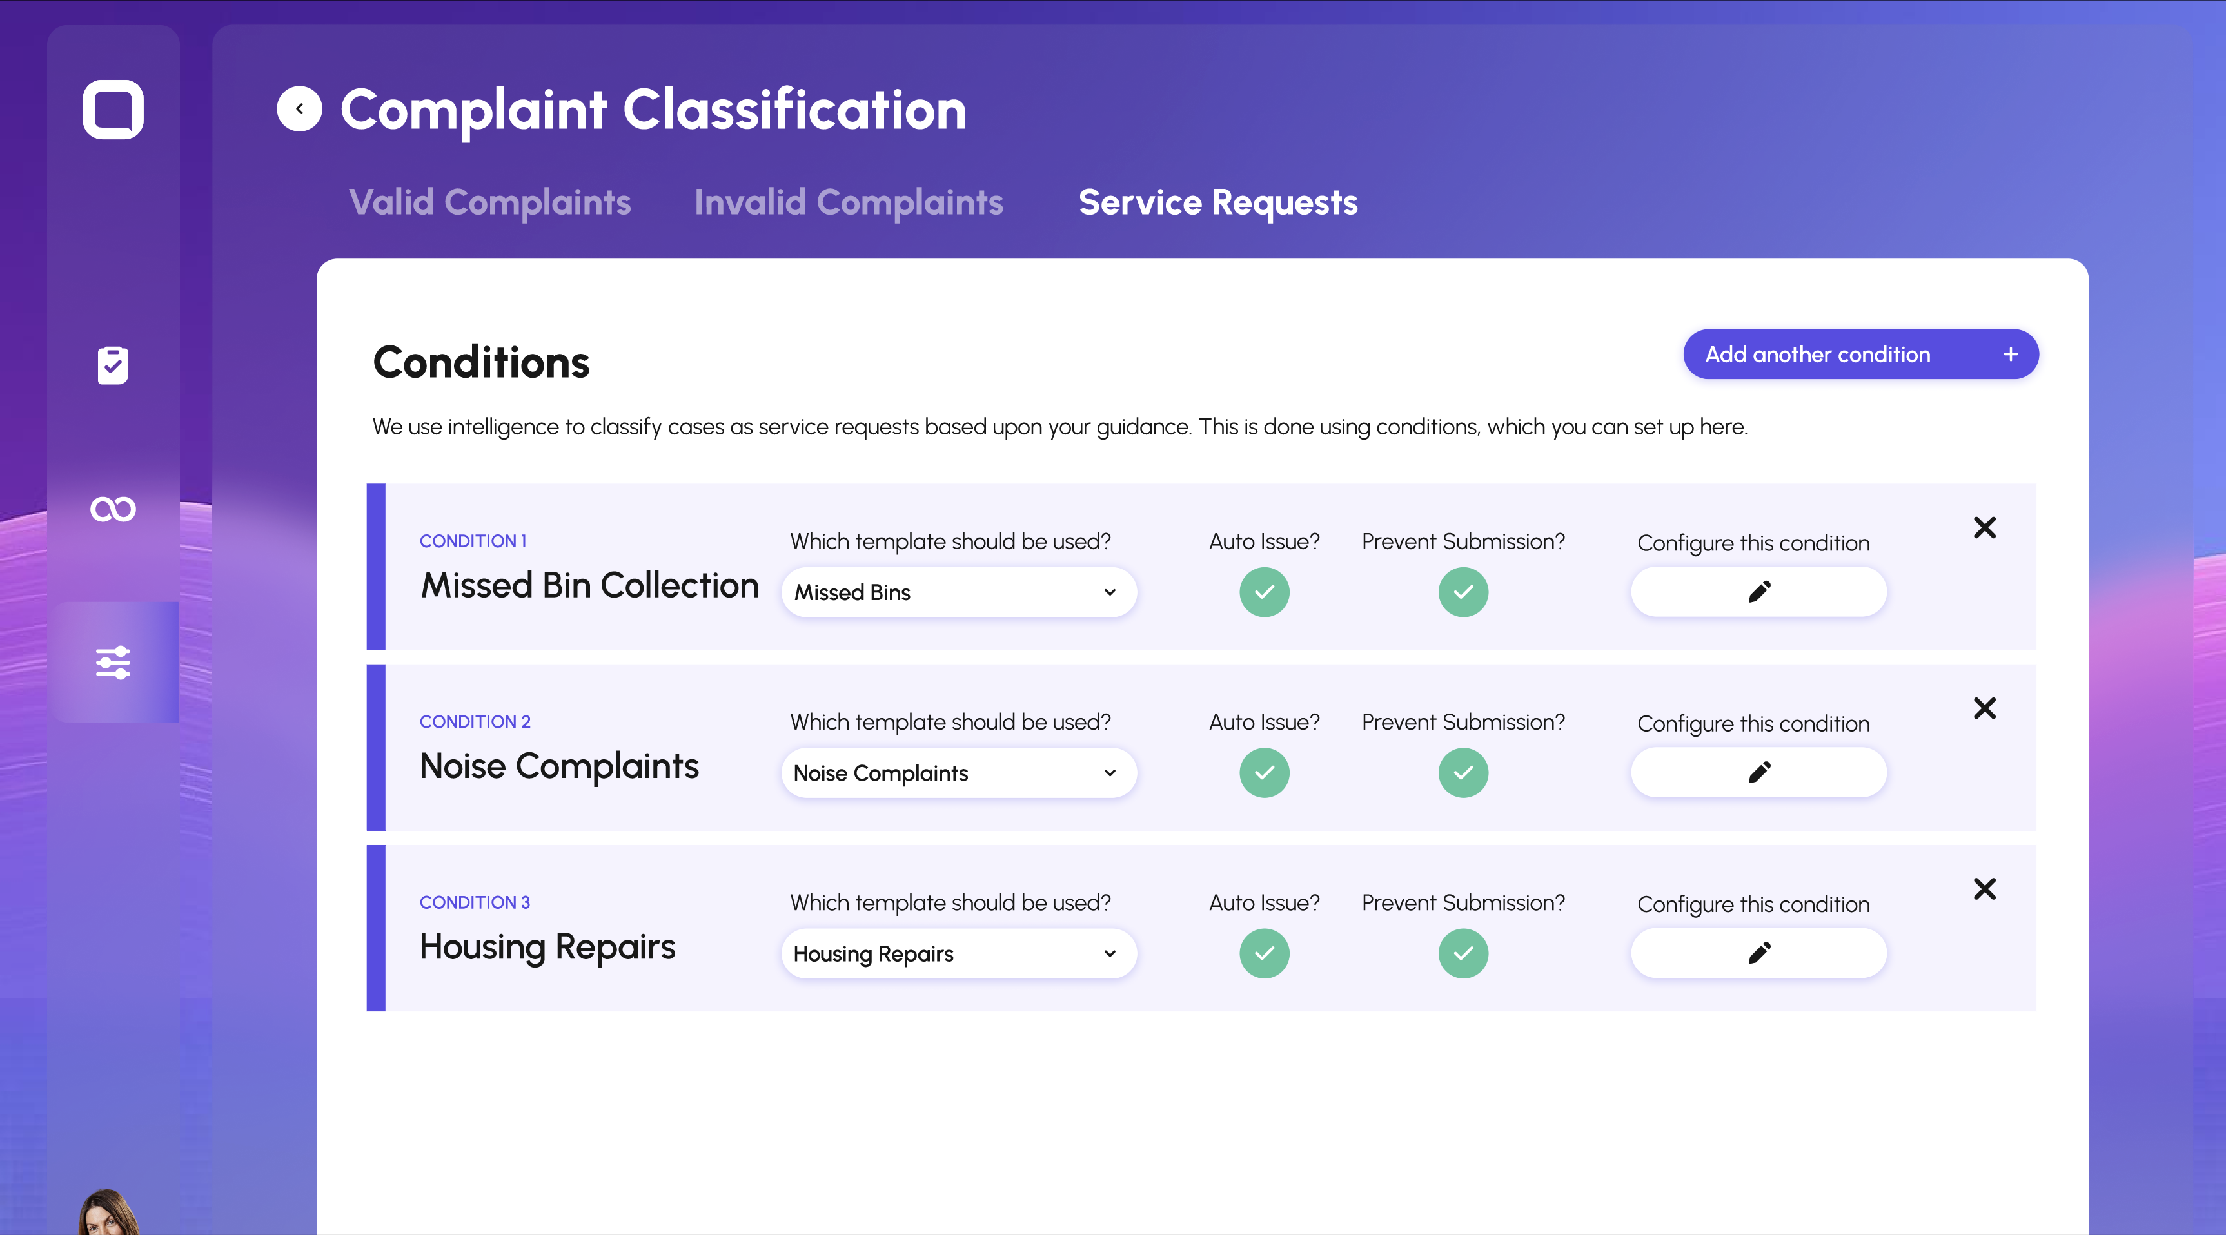

Slide 17
1
2
3
4
5
6
7
8
9
0
May 2025
We built Octavia because
SLACS
1
2
3
4
5
6
7
8
9
10

Slide 18
We ❤️ Complaints
1
2
3
4
5
6
7
8
9
0
May 2025
And understanding processes
SLACS
1
2
3
4
5
6
7
8
9
10

Slide 19

We ❤️ Complaints
We ❤️

Slide 20
AI Adoption Curve
Multi-agent
Multi-Agent
Total automation
Examples:
A full team of AI ‘users’
20x
Call Centre
Almost total automation
Examples:
Call handling
7x

Slide 21
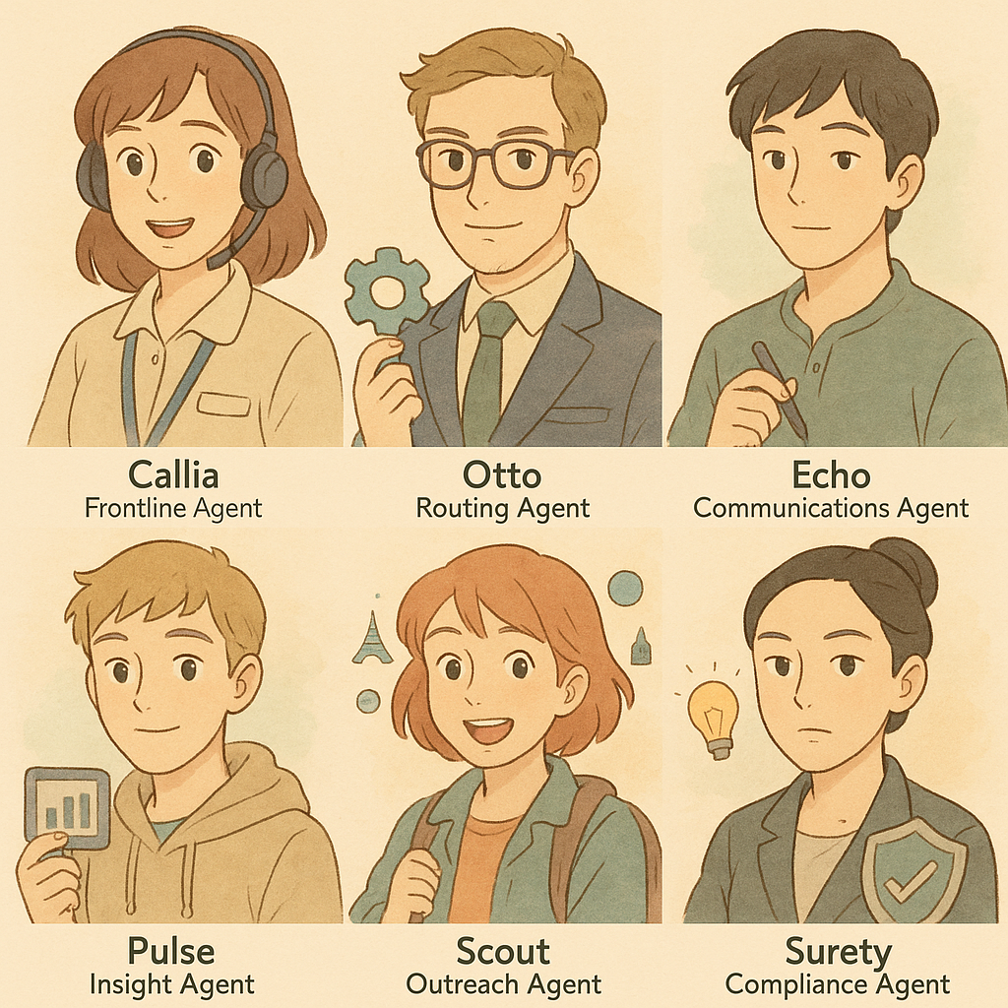
Callia - answers 90% of calls
Otto - updates your CRM
Echo - Knowledge engine
Pulse - analyses calls for sentiment
Scout - proactively messages to prevent calls
Surety - checks every box is ticked

Slide 22
AI Adoption Curve
Multi-agent
How long before this is real?
Total automation
Examples:
A full team of AI ‘users’
20x
Almost total automation
Examples:
Call handling
7x

Slide 23
Find out more
https://landing.govmetric.com/slacs-2025

