Slide 1

Transforming Customer Experience at Redbridge Council
Abbi Cole, Digital Programme Lead

Slide 2

Where we started
Our approach
Using AI
What we learnt
What we did
Measuring the impact
What’s next?
Notes:
Started content rebuild April 2024, went live with govmetric end of 2023 – how we used that data to inform the work

Slide 3
Where we started

Slide 4
High volume of calls
1 corporate centre and several small customer services teams - multiple contact centres / diff front doors
Multiple phone numbers
Over 80 different emails on the website
High volume of emails
Emails being used as a way to manage cases
All of which led to…

Slide 5

% rating experience as ‘Good’
(2024)
Phone: 46%
Sample size: 9,291
Web: 25%
Sample size: 21,282
Email: 30%
Sample size: 1,053

Slide 6
There were
8.5 million
visits to the Redbridge website in 2024…
…and
21,282
pieces of feedback for the website through GovMetric
Notes:
We also answered around 210k calls last year – but govmetric helped us triangulate and map our failure demand as ….

Slide 7

52%
tried online before calling in
12,308 hours
that could have been saved if our online offering was better
~250k
Why? They couldn’t find what they were looking for online
Source: GovMetric 1st Jan 25 – 12th May 25
Notes:
We knew our web content was bad, but govmetric confirmed that and helped us pinpoint the problem
Its not all about savings but sometimes its helpful to quantify what it was costing us
Why were they calling in ? Main reason – they couldn’t find what they were looking for

Slide 8


“I needed to speak to someone as your own website contradicts email you sent me. How does department dealing with customers don’t have a phone number I don’t understand but I guess it’s not that important.”
“Information I am looking NOT on the website…Appropriate department don’t answer the phones. Takes 2 weeks to answer an email.”
“I can’t find council tax statements the website is not very user friendly at all in my opinion”
Source: Customer Satisfaction Survey, data from GovMetric
Notes:
One of the issues we have is that often our back offices don’t recognise the impact of small

Slide 9
Using this satisfaction data, we could build a comprehensive, multi-dimensional understanding of resident needs, and used it to identify the cycle of failure demand
2nd touchpoint – can’t find what they are looking for on the web
3rd touchpoint – no response to their email or confidence that it has been picked up
2
Phone
Email
3
Leads to a decrease in satisfaction
Often told to email in
And an increase in customers using more costly channels
1st touchpoint – resident wanting to complete their transaction online
1
4
Website
Face to Face
Notes:
We combined multiple feedback channels—SMS surveys for telephone interactions, QR Code surveys for face-to-face experiences, and direct email surveys—to
One of the issues we have is that often our back offices don’t recognise the impact of small

Slide 10
Our approach

Slide 11
What triggers content creation and changes?
What happens when content does not meet residents’ needs?

Slide 12
Interviewed contact centre & social media colleagues, alongside user research with residents
Reviewed feedback
Assessed user journeys with residents
Used volumetric data (page views, calls, complaints)
Notes:
Kicked off April 2024 using a Content Design company for first few months
We did this by interviewing web authors (4 interviews) to hear first hand how they are working.

Slide 13
Interviewed contact centre & social media colleagues
Reviewed feedback
Assessed user journeys
Used volumetric data to prioritise high demand areas
Notes:
Kicked off April 2024 using a Content Design company for first few months

Slide 14
Using AI to help analyse GovMetric data

Slide 15
Prompt 1: Review this document. you are a data analyst but also a customer service expert. the goal is to categorise all of the key comment themes and do a count of how many per theme or category. produce in a table format with following headings: category, count of category, trend, insights. Quality control, there are 2873 comments so final count should be 2873
Using Copilot* to analyse quantitative data
Prompt 2: What are the technical limitations that prevent customers from completing their journey or transaction? specifically focus on comments that identify something is not working as it should
*GovMetric are to embed CX Insights – a tool that will incorporate AI-powered analysis directly into the platform.
Notes:
We used Copilot to help us effectively analyse all the free-text comments

Slide 16
Parking:
Which enabled us to drill down on the root causes
in each service area
Online Payment and Booking Systems:
Users face difficulties with the online payment system, including problems with processing payments and setting up direct debits.
The online booking system for parking permits is frequently down or slow, causing frustration and preventing users from securing permits in a timely manner.
Website Navigation and Functionality:
The website is difficult to navigate, with users struggling to find relevant information about parking regulations, fees, and permit applications.
Links on the parking page often do not work, leading to dead ends and preventing users from completing their intended actions.
Account Access and Information:
Users struggle to view their parking account information, including balances and payment history, due to poor website functionality.
The system does not display real-time information, causing delays and confusion about payment statuses.
Notes:
This translates in to complaints

Slide 17
What we learnt

Slide 18
What we learnt
Web authors have other responsibilities, and demand for content varies.
Many content changes happen reactively.
When content does not meet residents’ needs, it adds pressure to services and the contact centre.
Web authors have deep expertise in their areas and care about providing a good service for residents.

Slide 19
What we did

Slide 20
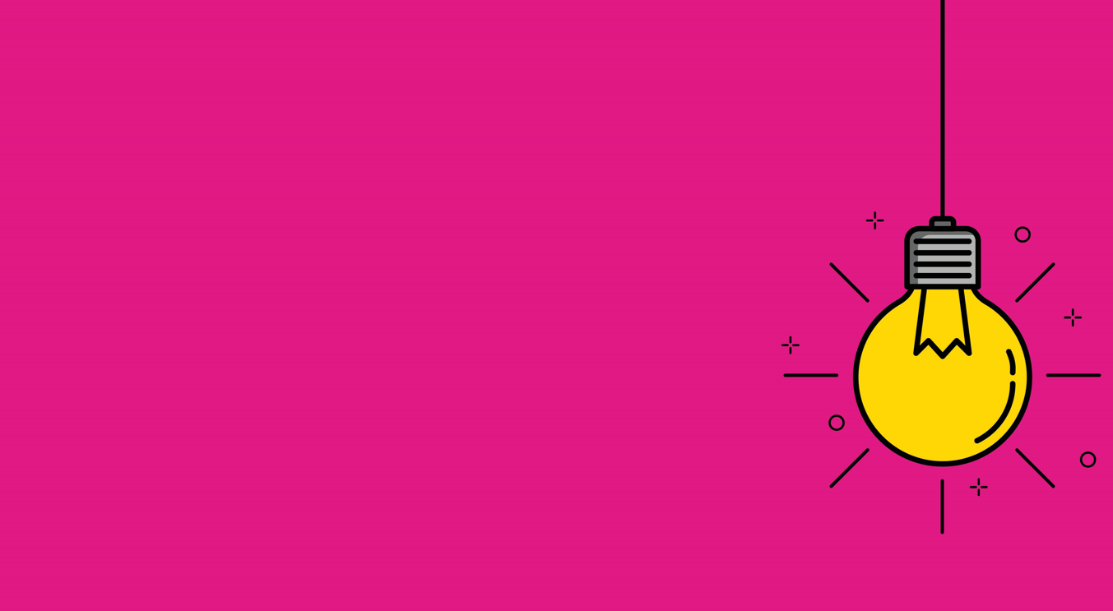
Consolidated pages
Created online forms
Enhanced customer journeys by structuring landing and content pages with top tasks
Low readability score on content pages
Removed PDF documents where possible.
Library of content patterns
Established our tone of voice for content
Notes:
Consolidated pages where possible on the website
Created online forms whenever a resident wants to tell us something, request something or pay for something. This provides a streamless experience without them having to leave the website
Enhanced customer journeys by structuring landing and content pages with top tasks
Low readability score on content pages to ensure users can easily read it
Removed PDF documents where possible. They’re difficult to read on mobile phones and not accessible for people using assistive technology
Library of content patterns
Established our tone of voice for content

Slide 21
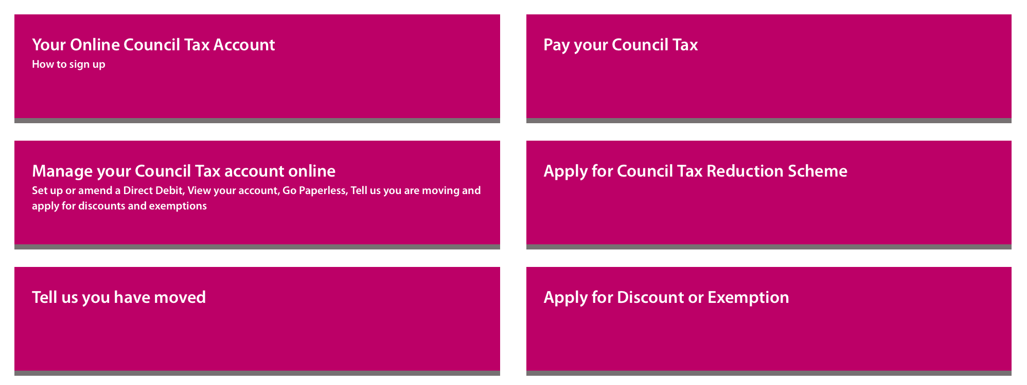
Council Tax landing page: before
Notes:
This in-page navigation on the main Council Tax landing page page
This the old version.
This first page in the primary nav [highlight top left] links to instructions.
Those instructions ask people to come back to this landing page and choose what’s now the ’Manage your Council Tax account online page.

Slide 22
Circular journey
Email
Council Tax landing page
Your online Council Tax account
Contact us
Notes:
This is a visualisation for the journey - it’s circular.
We can see front the web stats that people who are referred back to the Council Tax landing page are exiting to the contact us page.
They’re also being driven to the contact us page from here [gesture to Your online Council Tax account].
For this reason we’re suggesting that you deleted the ‘Online Council Tax account page from the nav and making further changes…

Slide 23
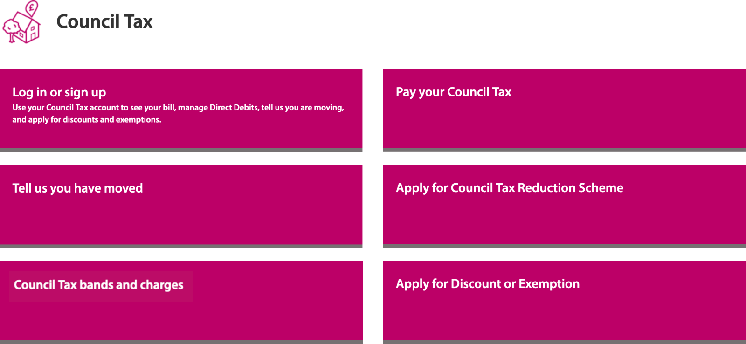
Council Tax landing page: after
Notes:
Delete ‘Your online tax account’
Rename Manage your Council Tax Account
Main label is: Log in or sign up
And the description text: “Use your Council Tax account to see your bill, manage Direct Debits, tell us you are moving, and apply for discounts and exemptions.”
That’s because page feedback also told us that people on here wanted to find out how much they owed and wanted to know how to take the next step.
We’re suggesting adding the ‘Council tax bands and charges’ page to here because it’s the most visited page in the Council Tax section. that is not in this nav yet.

Slide 24
Council Tax web pages: before
Old structure​ | New structure ​
Web pages - 28​ | Web pages - 22​
PDF - 9​ | PDF - 1​
Email address - 6​ | No email addresses​
Phone numbers - 4​ | No phone numbers ​
Notes:
Delete ‘Your online tax account’
Rename Manage your Council Tax Account
Main label is: Log in or sign up
And the description text: “Use your Council Tax account to see your bill, manage Direct Debits, tell us you are moving, and apply for discounts and exemptions.”
That’s because page feedback also told us that people on here wanted to find out how much they owed and wanted to know how to take the next step.
We’re suggesting adding the ‘Council tax bands and charges’ page to here because it’s the most visited page in the Council Tax section. that is not in this nav yet.

Slide 25
Council Tax web pages: after
Old structure​ | New structure ​
Web pages - 28​ | Web pages - 22​
PDF - 9​ | PDF - 1​
Email address - 6​ | No email addresses​
Phone numbers - 4​ | No phone numbers ​
Notes:
Delete ‘Your online tax account’
Rename Manage your Council Tax Account
Main label is: Log in or sign up
And the description text: “Use your Council Tax account to see your bill, manage Direct Debits, tell us you are moving, and apply for discounts and exemptions.”
That’s because page feedback also told us that people on here wanted to find out how much they owed and wanted to know how to take the next step.
We’re suggesting adding the ‘Council tax bands and charges’ page to here because it’s the most visited page in the Council Tax section. that is not in this nav yet.

Slide 26
Measuring the impact

Slide 27
Tracking the impact of the content changes by:
Web analytics
GovMetric feedback
Search analytics
Call data
Notes:
We’re measuring the performance of our new content pages. We'll use this data to continue to make improvements to the website, based on evidence and feedback.
Web analytics will tell us how engaged users are with the website content. Using metrics such as views, average time on site, and engagement rate will help check if visitors are finding the information they need and interacting with the content.
Search analytics: This will allow us to get insight into what our users are looking for on the website and which results they select such as popular searches, no results and click-through rates.
GovMetric feedback
GovMetric is helping us gather feedback from our users about the experiences they have when interacting with the content. An increased customer satisfaction rate will show us that we have made an improvement in customer experience.
Call data
A reduction in calls to the customer contact centre will show that our users are finding what they need through the content on the website without the need to contact us.

Slide 28
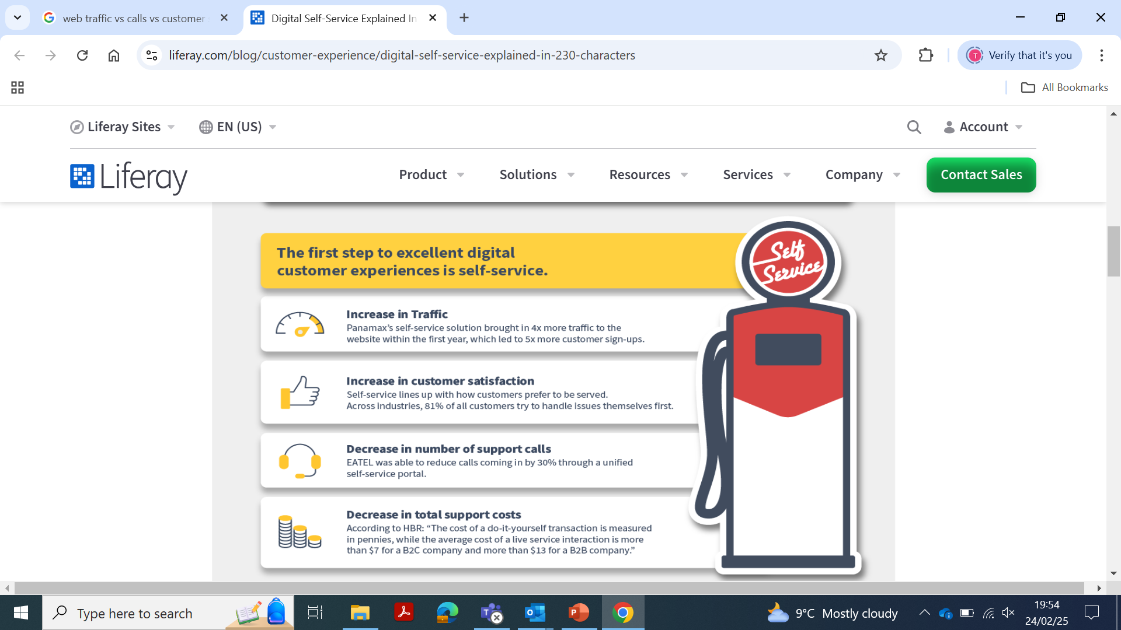
What we’re seeing
Increase in web traffic
Decrease in calls
Increase in customer satisfaction
in all service areas
in all service areas
measured as positive rating on GovMetric
Council Tax page views
Council Tax
phone calls
81,395
January
67,555
December
50,212
November
3,995
January
3,298
December
3,649
November
14%
rated as good
July ‘24 – Sept ‘24
+6pp
20%
rated as good
Oct ‘24 – Feb ‘25

Slide 29
Council Tax call volumes
February year-on-year
Council Tax calls in 2024 rose by +11% vs 2023
+7%
-12%

Slide 30
Average % increase of calls in 2024 vs 2023
July – September
October - December
+36%
+11%
Notes:
And that is despite comms going out in December about rising council tax

Slide 31


What users are telling us…
Like the use of consistent terms e.g. Council Tax reference number
Using the phase ‘other’ is not helpful
Easy to understand and process the information
Like how complex terms are explained clearly
Useful to have details of what you need to do before applying or requesting
Call to action on the pages are easy to find

Slide 32




Web content live in…
Council Tax
Removed:
6 content pages
6 email addresses
4 phone numbers
8 PDF documents
created 6 new online forms
Births, deaths, marriages and civil partnerships
Removed:
11 content pages
18 email addresses
6 phone numbers removed
1 PDF document
created 7 new online forms
Benefits
Removed:
33 content pages
14 email addresses
14 phone numbers
6 PDF documents
created 2 new online forms
Schools, Parking and Bins Waste and Recycling
Top tasks redesigned:
12 content pages
created 9 new online forms
Notes:
This isn’t just a website fix—it’s a fundamental shift in how local government serves and empowers residents:
Rising trust in digital channels
Reduced frontline pressure, enabling more focus on complex resident needs
AI-powered insights driving rapid, resident-led improvements
Increased satisfaction and digital inclusion

Slide 33
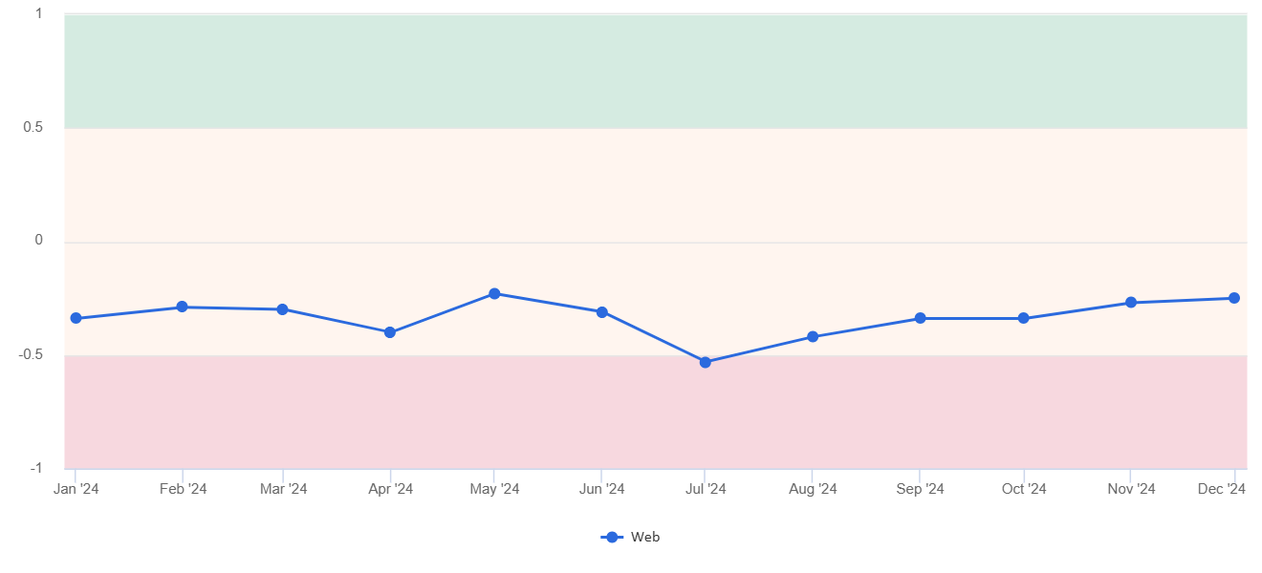
Net satisfaction on the website improved towards the end of 2024, driven by changes in web content
We’ve seen an +8pp increase in positive satisfaction ratings post content go live
Net satisfaction on the web in 2024 (monthly view)
Content design work goes live

Slide 34
Challenges
Time and commitment from officers
Officers wanting to include everything on pages
Thinking from the view of the user
Notes:
Getting officers time and commitment as this is tagged to they day to day jobOfficers wanting to add and include everything to ‘cover themselves’. And wanting to use jargon language as that’s how we speak in the councilGetting the service to think from a user need point of view. What does the user need to know on the page not what the service wants to tell them.

Slide 35
What’s next?

Slide 36
Web content roadmap
April 25
July 25
May 25
June 25
Ensure content components available for a better user experience
Test and audit content and interactive elements to ensure they are functioning correctly
Upload new content and architecture
Train web authors across the service on the new content management systems
Create a library of resources for web authors
Stakeholder engagement and communications
Content governance - processes for the management, creation and publishing of web content
Messaging for go live including to web authors, members and stakeholders

Slide 37

Web content is one piece of the jigsaw
Web content owners and team
Voice Automation & Conversational AI
Customer platform & customer account
Roadmap
Service redesign
Consolidation of customer services
Notes:
Voice Automation & conversational AI
Looking to deflect 30-40% of calls
Consolidate customer serving functions and processes
Consistency, one-stop service, fewer hand-offs, streamlined processes, better use of tech, better data and insights, early intervention and prevention
Customer platform / single view of the customer
Wholesale service redesign

Slide 38
3 core elements to help us to get there
People & Culture
Processes & Technology
Strategy & Vision
Notes:
really fundamental part of measuring corporate performance and setting the baseline
Continue using feedback to not only identify root causes but critically to MEASURE the impact across all of our transformation projects
Standardising excellent customer experience – embedding feedback in to ways of working / 121s etc – culture
Redesign our processes - what is our to be processes – not limited by current technology
Strategy – what do we want our customer experience to look like for people – people with needs etc
Implement new and innovative technology

Slide 39
abaigeal.cole@redbridge.gov.uk

